Slide 1



CRIME IN MINNEAPOLIS 2022
Alexander Ecker, DJ Thapa, EJ Peris, Katelyn Walsh and Laura Murray

Slide 2

DATA

Slide 3
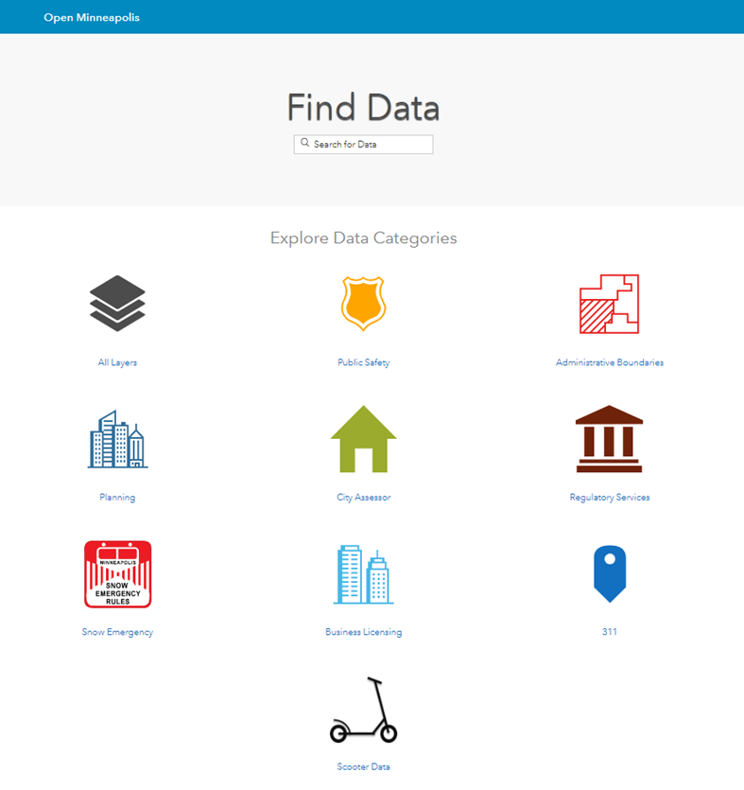
DATA SOURCE
The city of Minneapolis has data available at opendata.minneapolismn.gov
We chose to use the Public Safety and City Assessor data and used csv files
We merged the two datasets on Neighborhood to see correlations
Notes:
Alex

Slide 4
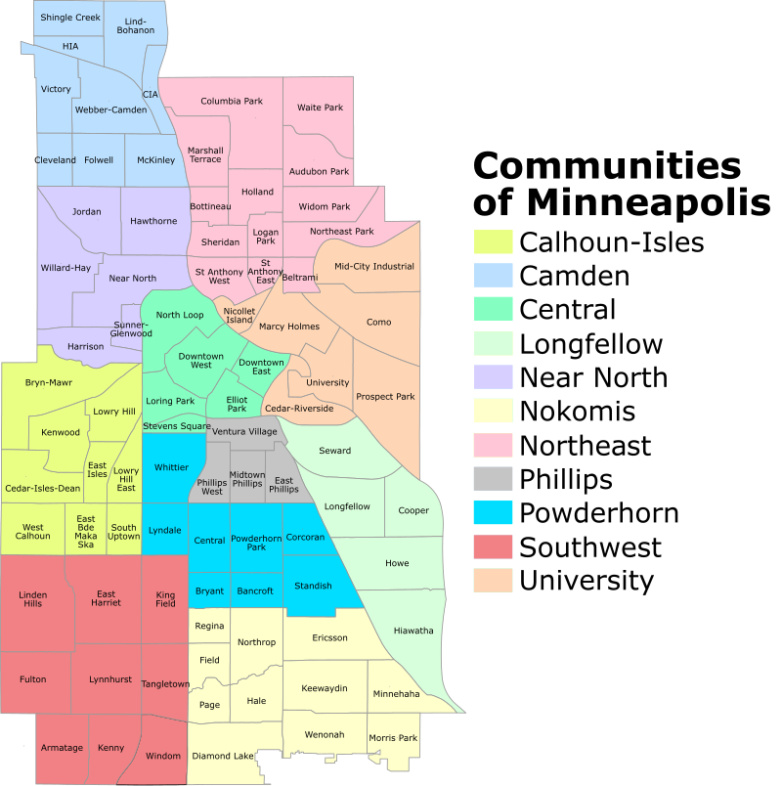
MINNEAPOLIS NEIGHBORHOODS
The city of Minneapolis has 83 residential neighborhoods that make up 11 communities.

Slide 5
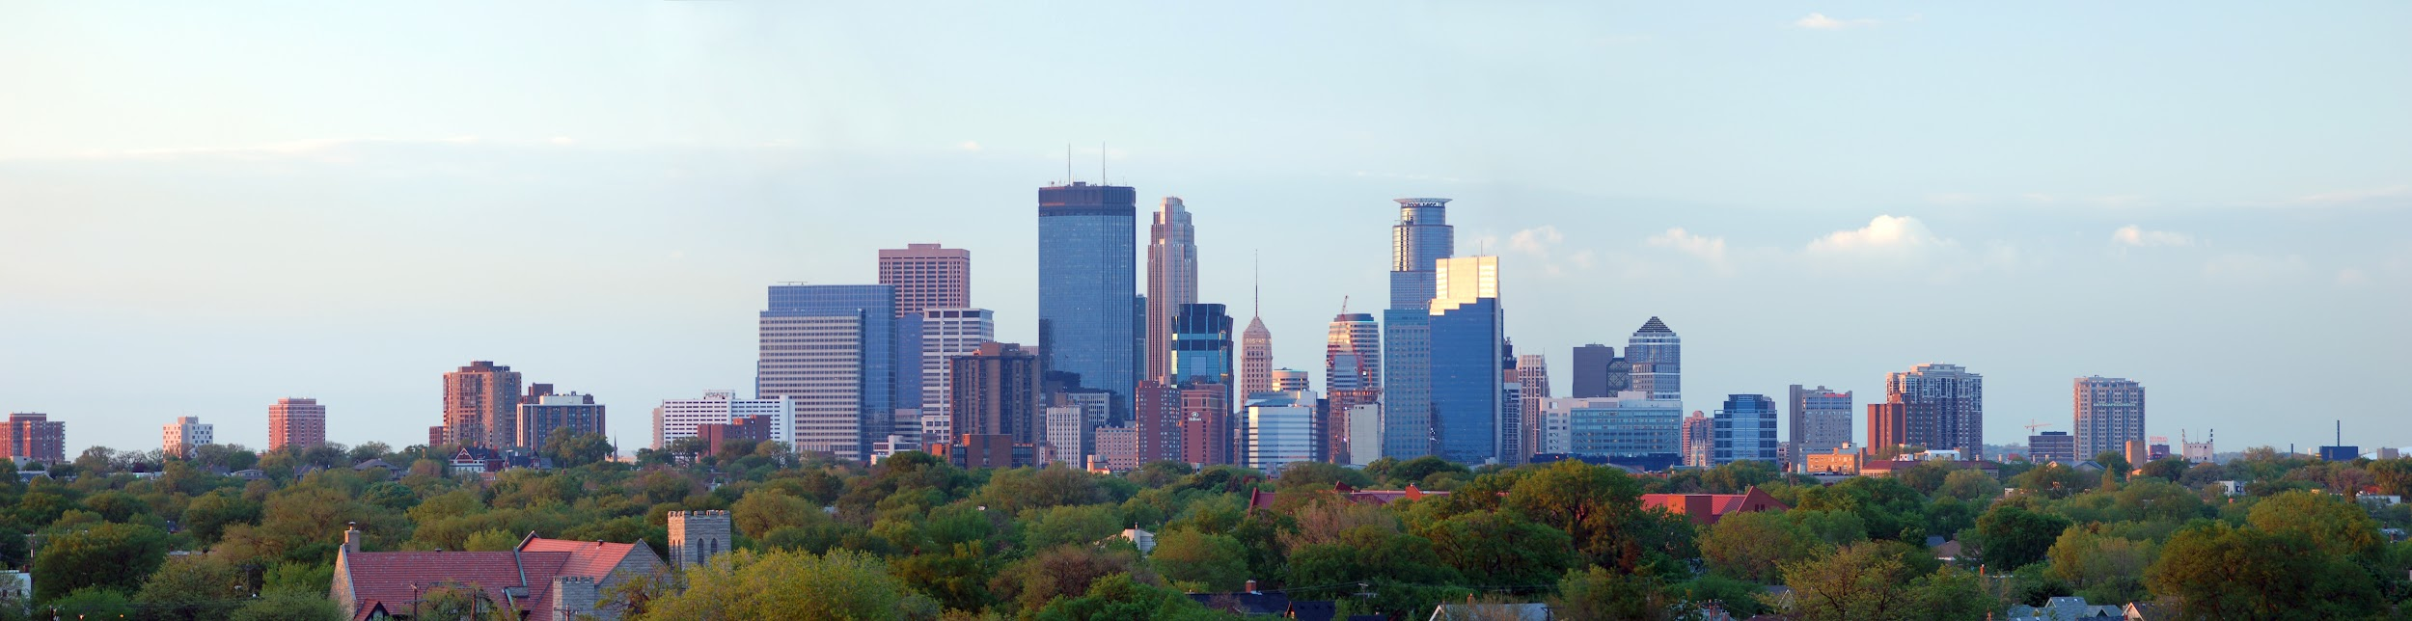
DEFINITIONS
Crime Count = Individual count of crime by type
Total Crime % = Crime Count / Total Count of crimes
Per Unit Value = Mean assessed property value per residential unit: Average of (Land Value + Building Value)/units
Notes:
Alex

Slide 6
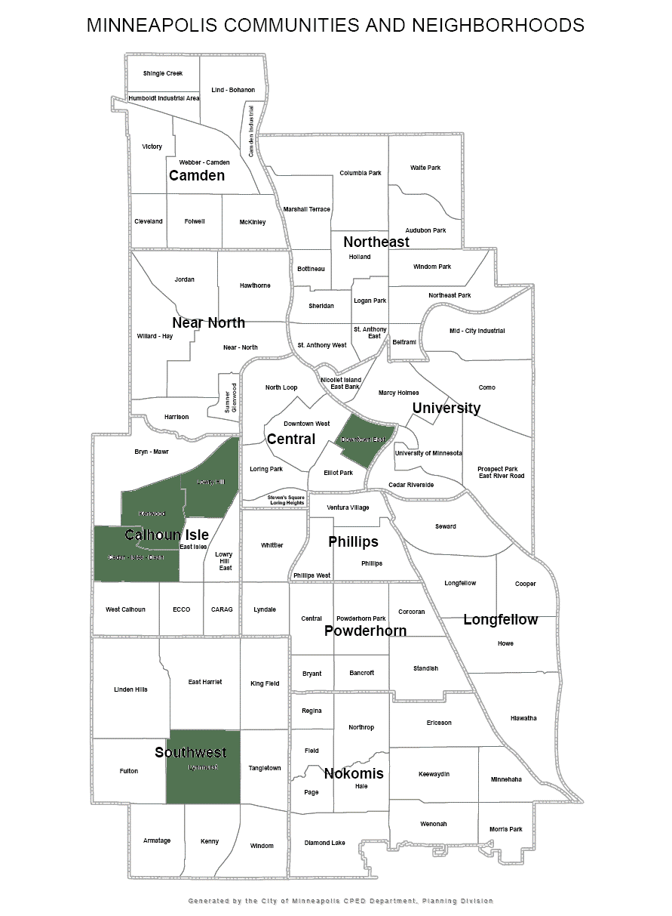
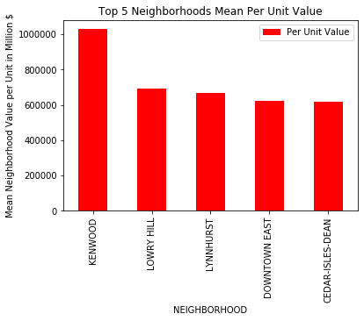
HIGHEST PER UNIT VALUE NEIGHBORHOODS 2022
These five neighborhoods have the highest mean assessed property value per residential unit. Kenwood’s mean value is $1,028,401/unit which is much higher than the next four which are in the $600,000/unit range.
Notes:
Laura

Slide 7
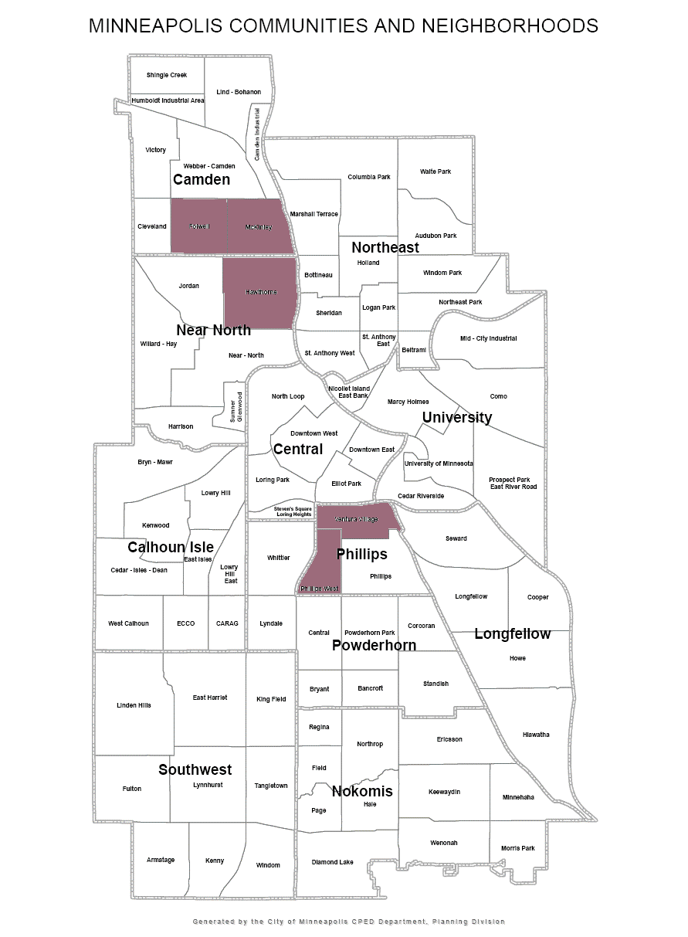
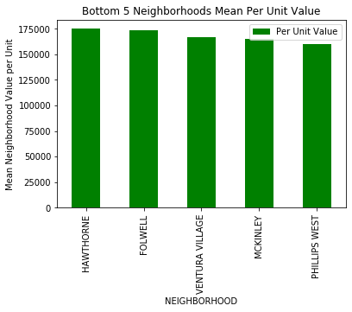
LOWEST FIVE PER UNIT VALUE NEIGHBORHOODS 2022
These five neighborhoods have the lowest mean assessed property value per residential unit. The range of the value per residential units among these five is small: $175,038/unit (Hawthorne) to $159,740/unit (Phillips West) - a difference of only $15,298.

Slide 8
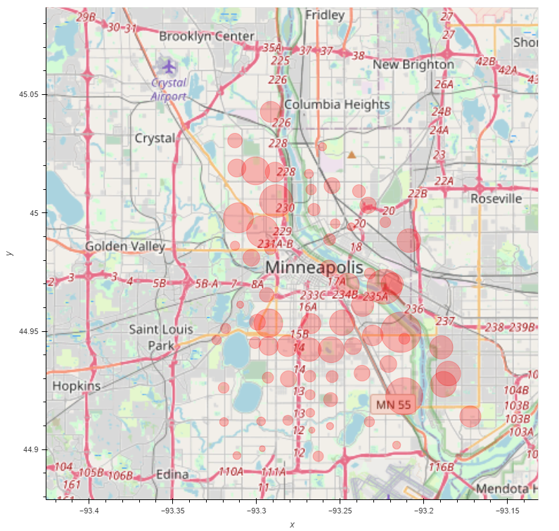
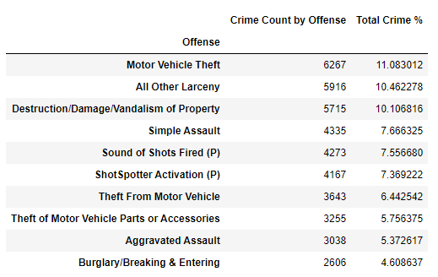
REPORTED OFFENSES IN MINNEAPOLIS 2022
There were 56,546 reported offenses in Minneapolis in 2022.
Out of 49 types of offenses in Minneapolis, Motor Vehicle Theft accounts for 11% of total crime
The ten most common offenses represent 73% of total offenses

Slide 9
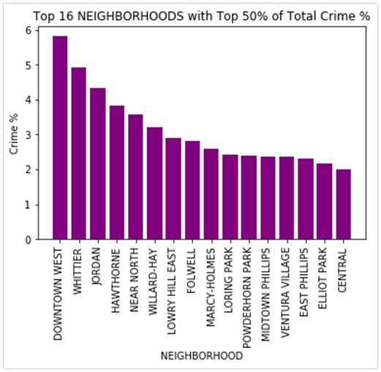
TOP 16 NEIGHBORHOODS WITH TOP 50% OF TOTAL CRIME

Slide 10
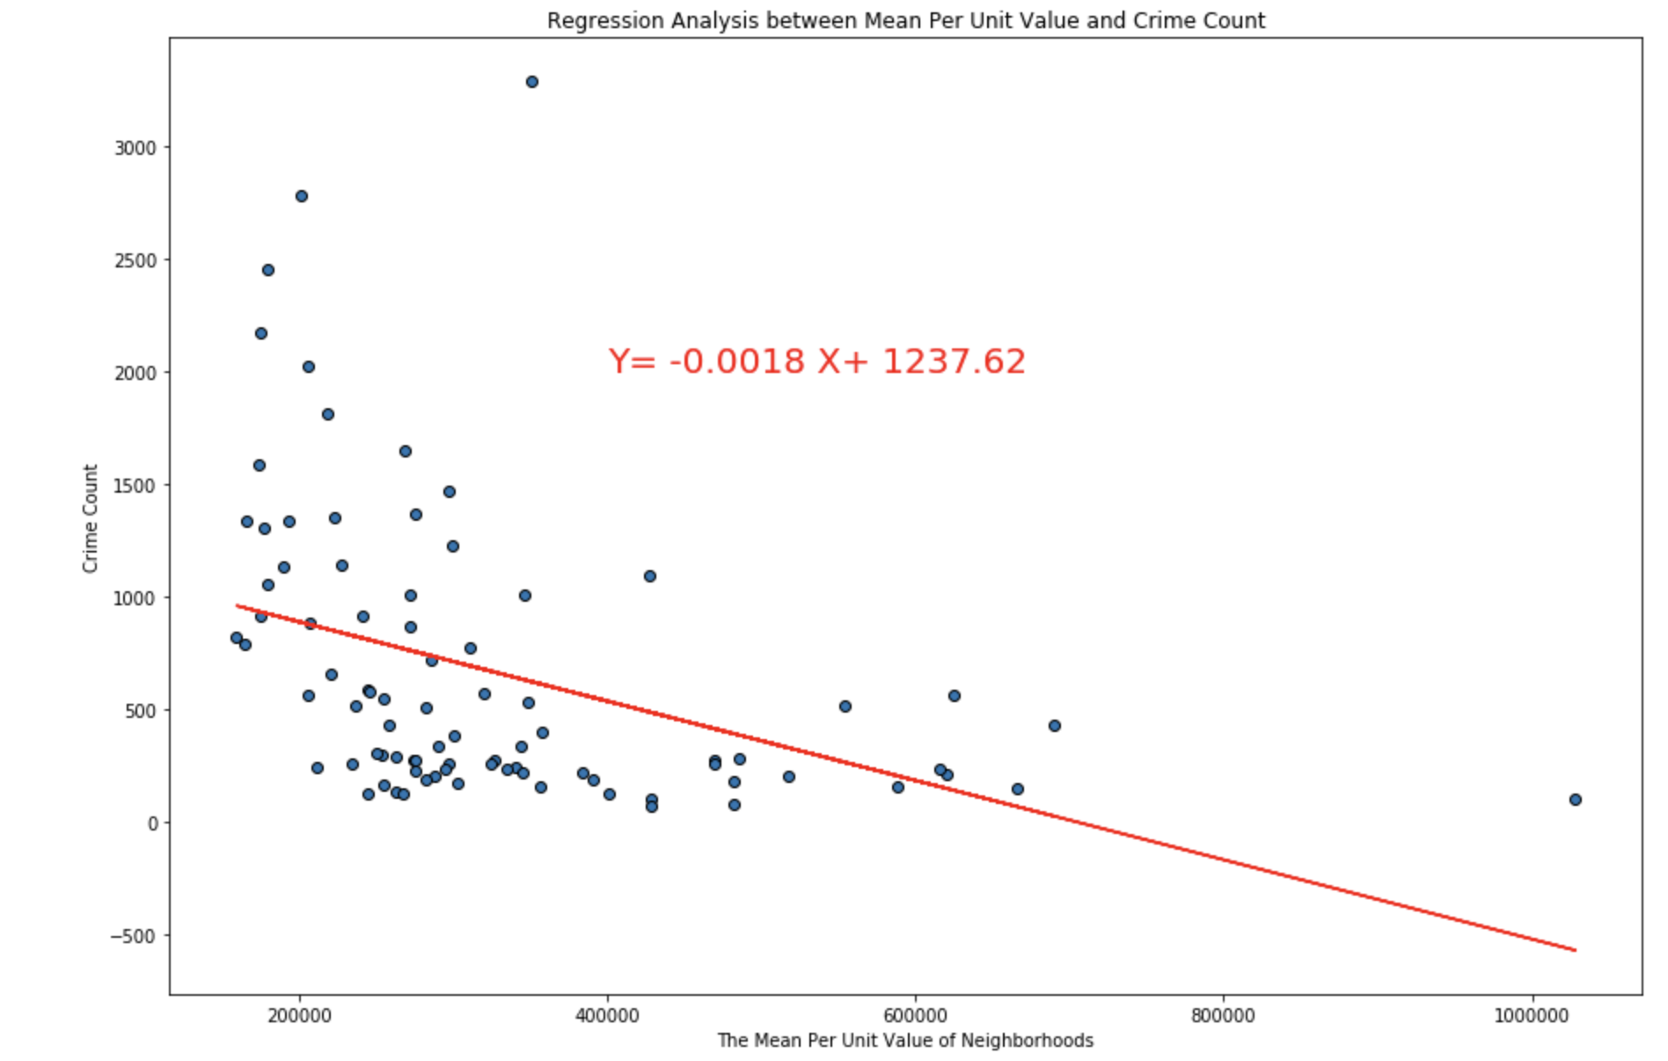
REGRESSION ANALYSIS BETWEEN MEAN PER UNIT VALUE AND CRIME COUNT
Correlation between per unit value and crime count among neighborhood is a weak negative correlation with a R-Value of -0.40.

Slide 11
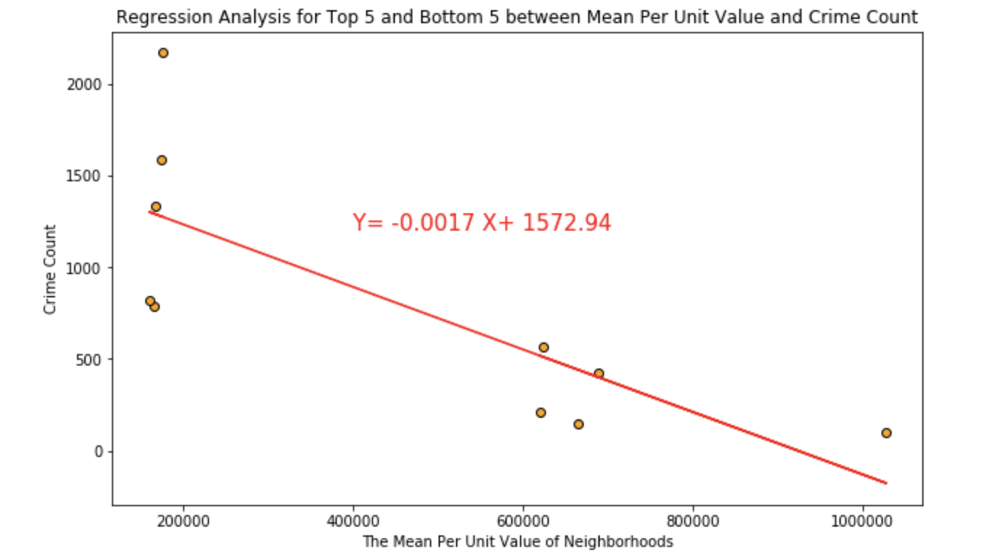
REGRESSION ANALYSIS BETWEEN MEAN PER UNIT VALUE AND CRIME COUNT WITH ONLY THE NEIGHBORHOODS WITH THE FIVE HIGHEST AND FIVE LOWEST PROPERTY VALUES
Correlation between per unit value and crime count among top and bottom 5 neighborhood is even stronger with a R-Value of -0.78.

Slide 12
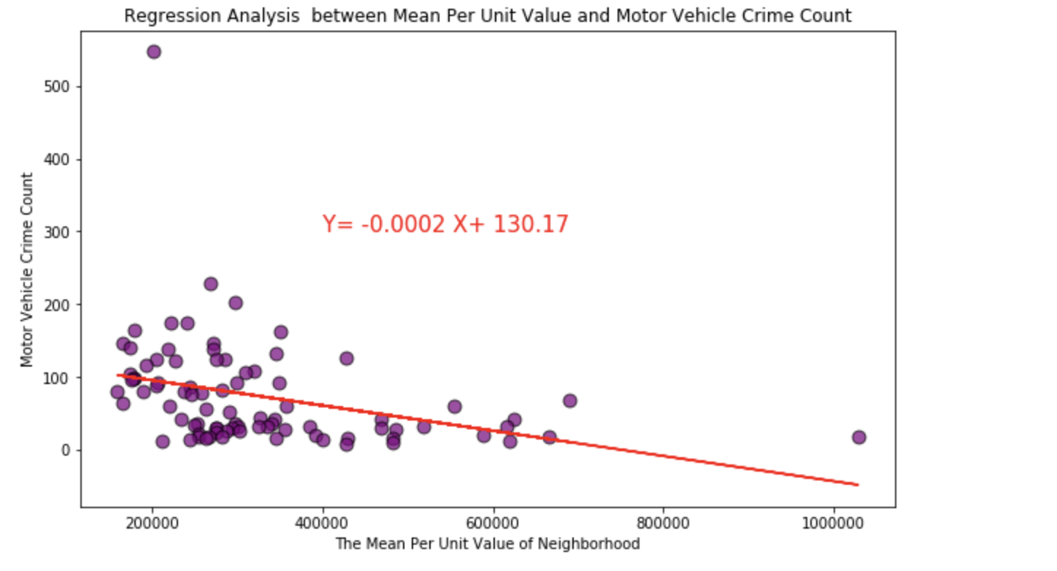
REGRESSION ANALYSIS BETWEEN MEAN PER UNIT VALUE AND MOTOR VEHICLE THEFT COUNT
Correlation between per unit value and crime count among top and bottom 5 neighborhood is even stronger with a R-Value of -0.34.

Slide 13
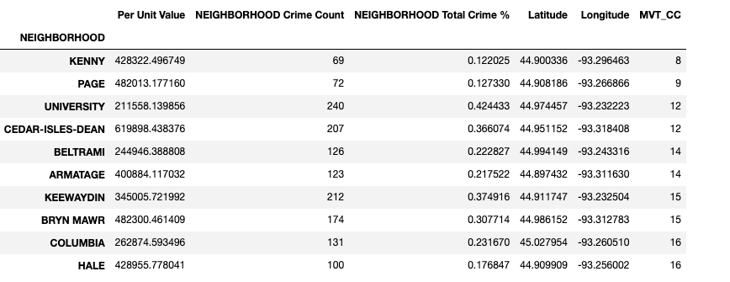
WHAT NEIGHBORHOODS?
Arrive at ideal neighborhood :
Double-sorted for lowest per unit value and motor vehicle count
Kenny and Page were the two best neighborhoods
Kenny: $428K with 8 count of MVT CC
Page: $482K with 9 count of MVT CC
Additional five crimes within these neighborhood
Kenny: motor vehicle parts, burglary, other larceny, vandalism, and simple assault
Page: vandalism, motor vehicle parts, simple assault, burglary, and other larceny

Slide 14
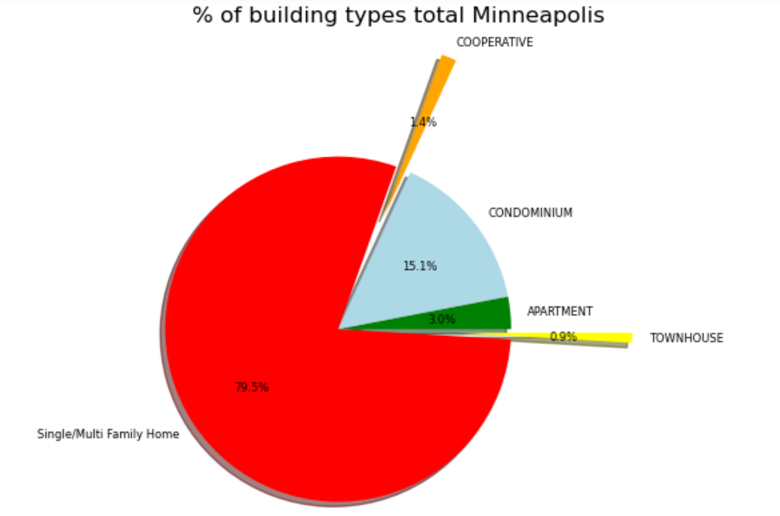
RESIDENTIAL BUILDING TYPES IN MINNEAPOLIS 2022
Breakdown of Minneapolis:
79.5% are single/multi family homes
15.1% are condominiums
5.3% are apartments, townhouses and cooperatives

Slide 15
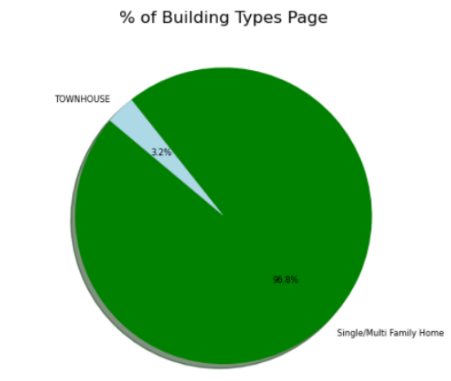
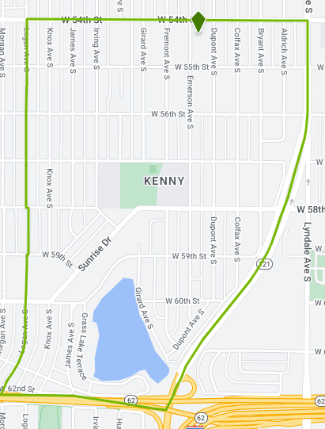
RESIDENTIAL BUILDING TYPES IN KENNY AND PAGE
PAGE
KENNY
Page has mostly single/multi-family homes, with a few townhouses.
Only single/multi family homes are found in Kenny. This graphic from apartments.com shows one property is a house for rent.

Slide 16
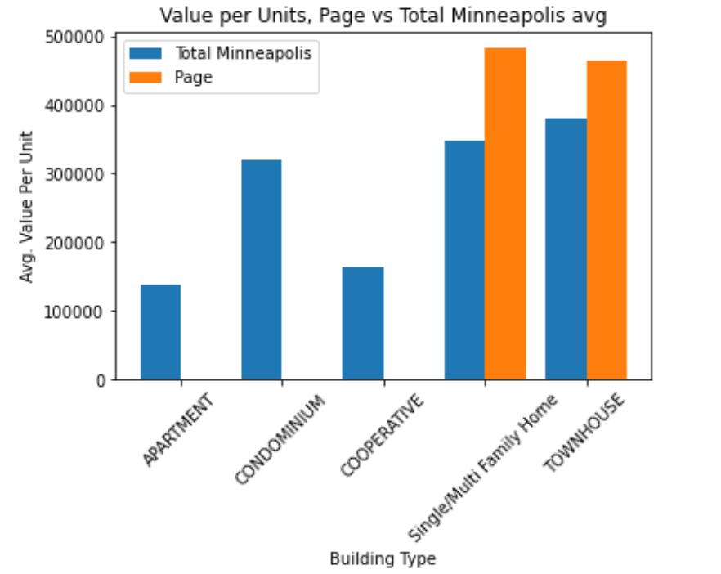
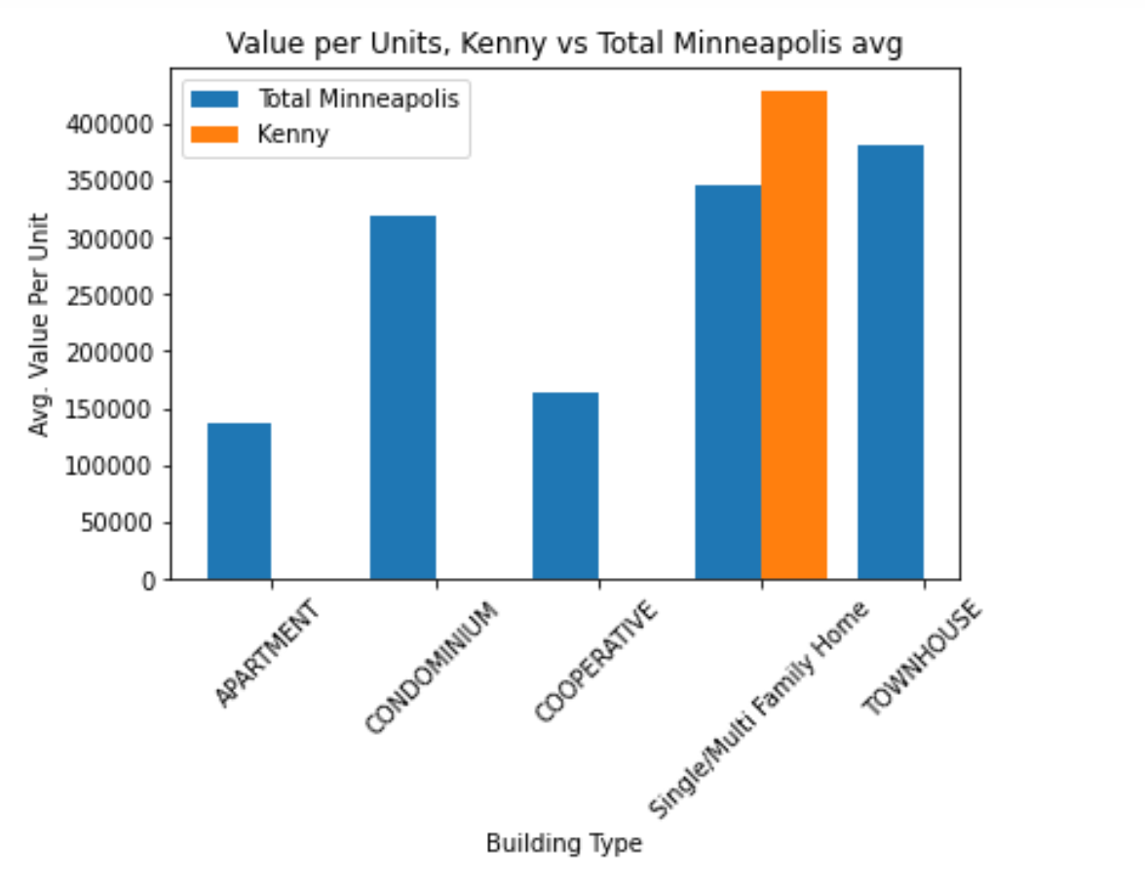
COMPARISON OF RESIDENTIAL VALUE PER UNIT IN KENNY AND PAGE
PAGE
KENNY
KENNY

Slide 17
ADDITIONAL CONSIDERATIONS
The Public Safety dataset does not account for unreported crime count.
The research team only looked at the most common crime when considering which neighborhoods to recommend. People have a subjective view on what crimes are more severe. For example, some may be more concerned with shots fired than motor vehicle theft.
The research team only used residential property types in the analysis. Vacant land, commercial properties, industrial properties were not included.
The wealth of a neighborhood was determined only using assessed property value. Per capita income, often used in determining wealth of a neighborhood,was not used.

Slide 18

QUESTIONS

Slide 19
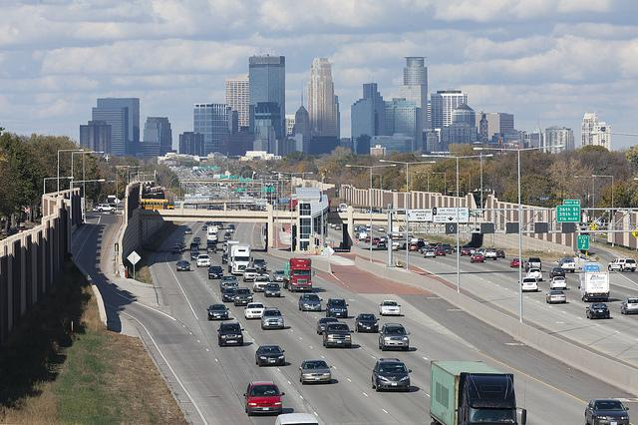
APPENDIX

Slide 20
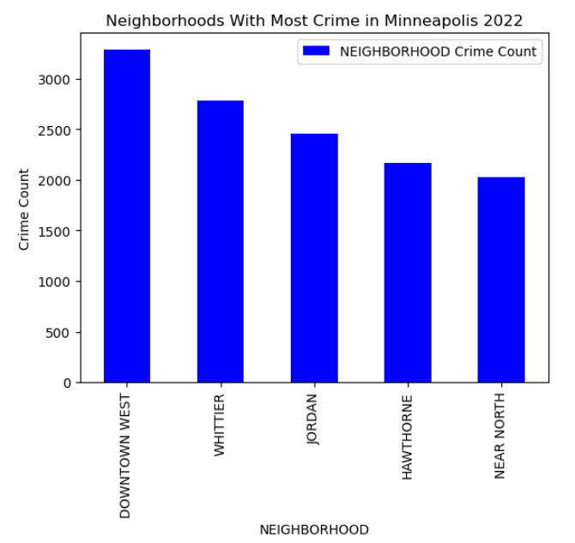
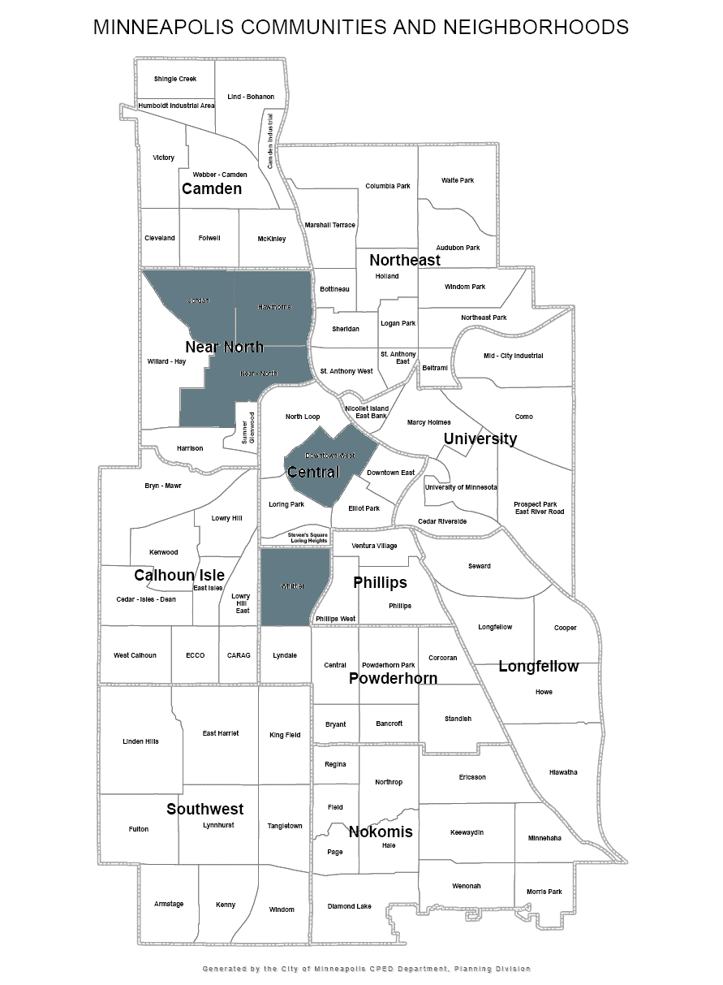
HIGHEST FIVE CRIME COUNT NEIGHBORHOODS 2022

Slide 21
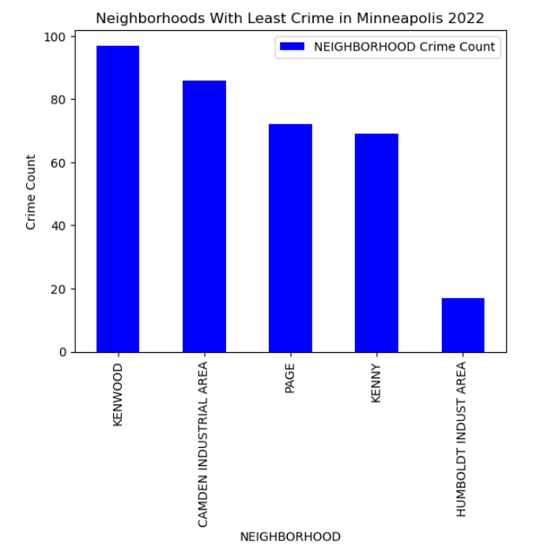
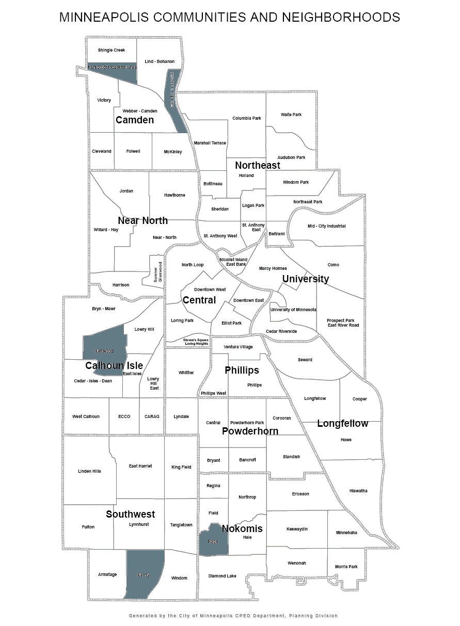
LOWEST FIVE CRIME COUNT NEIGHBORHOODS 2022

Slide 22
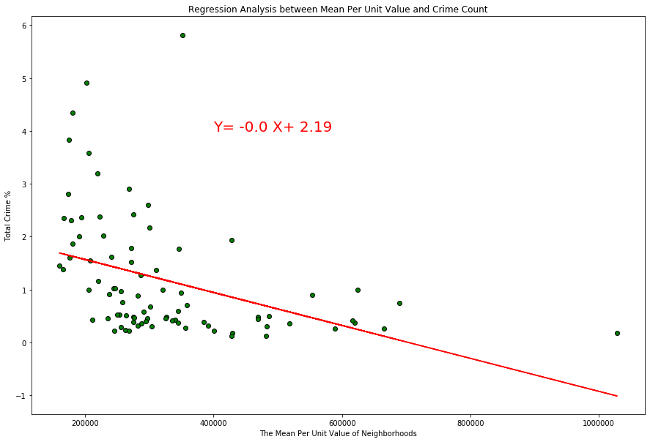
REGRESSION ANALYSIS BETWEEN MEAN PER UNIT VALUE AND TOTAL CRIME %

